Slide 1

Plan for the next Implementation

Slide 2
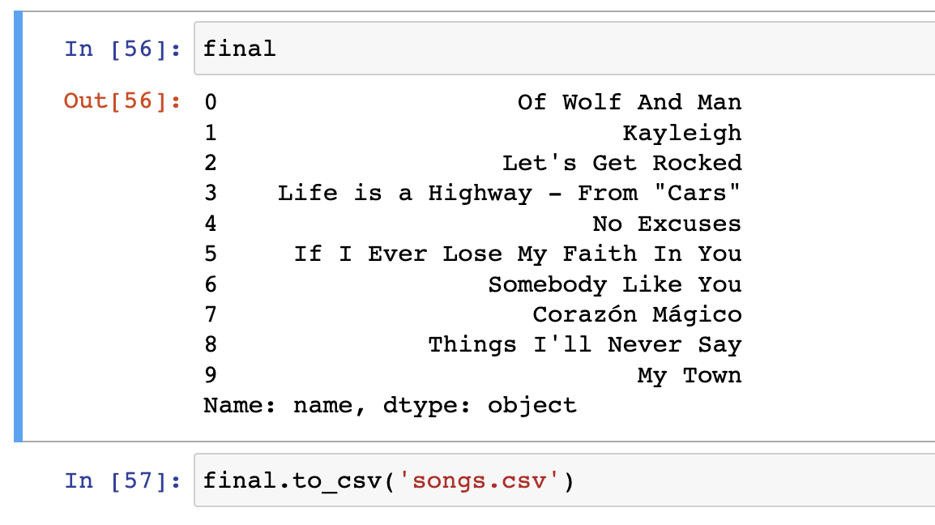
We got the list which we converted to csv

Slide 3
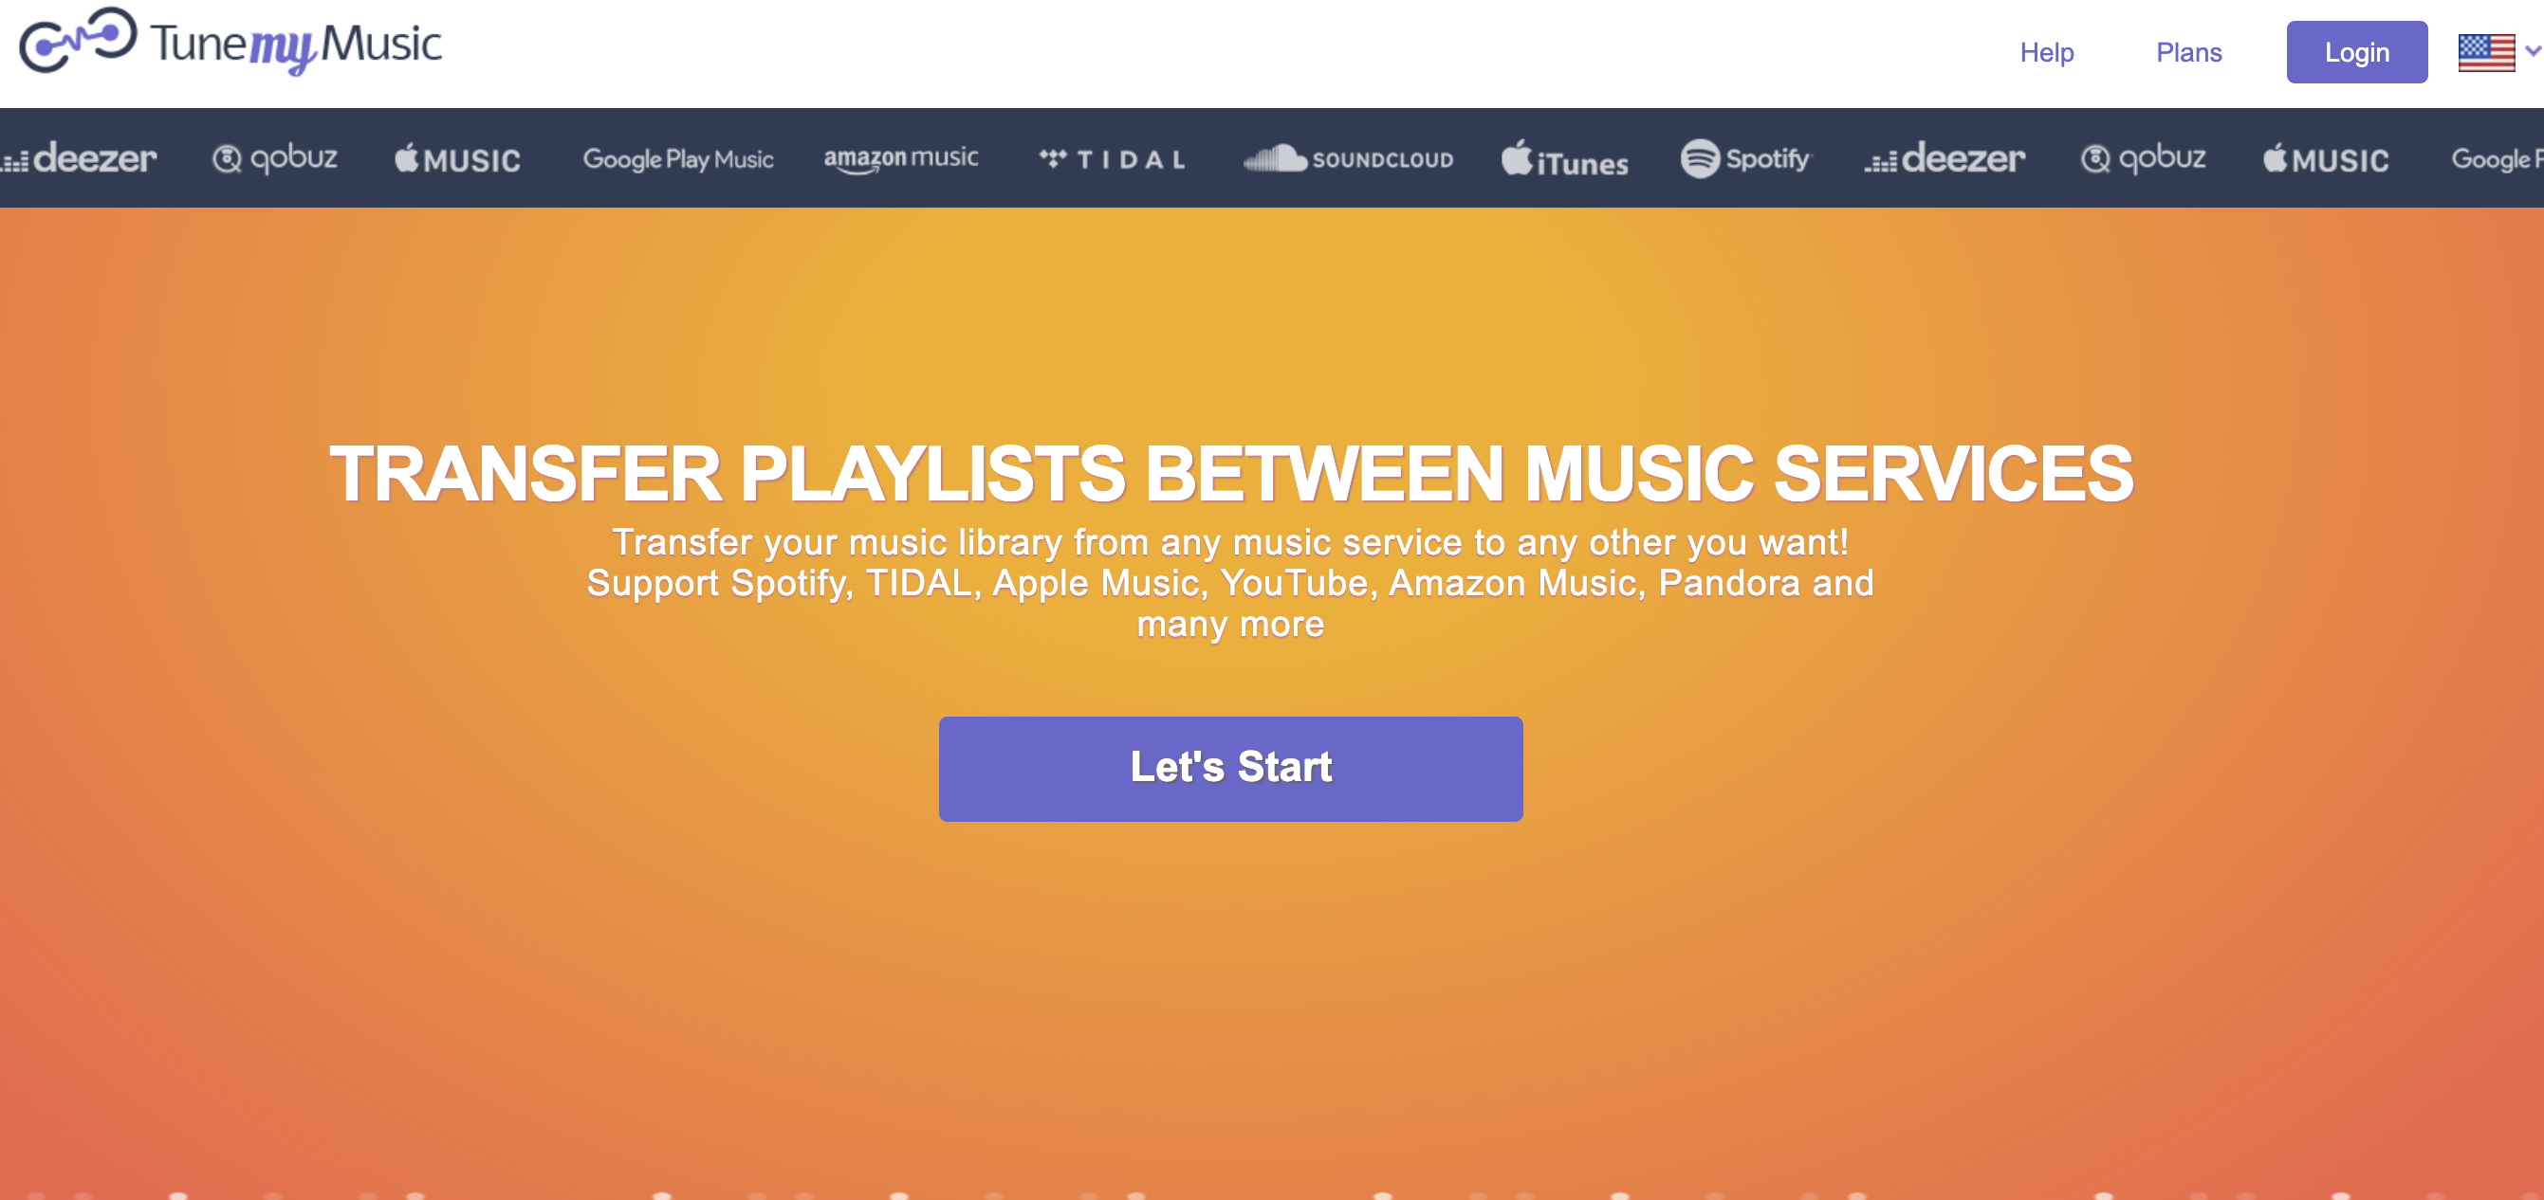
We will acess TunemyMusic using selenium

Slide 4
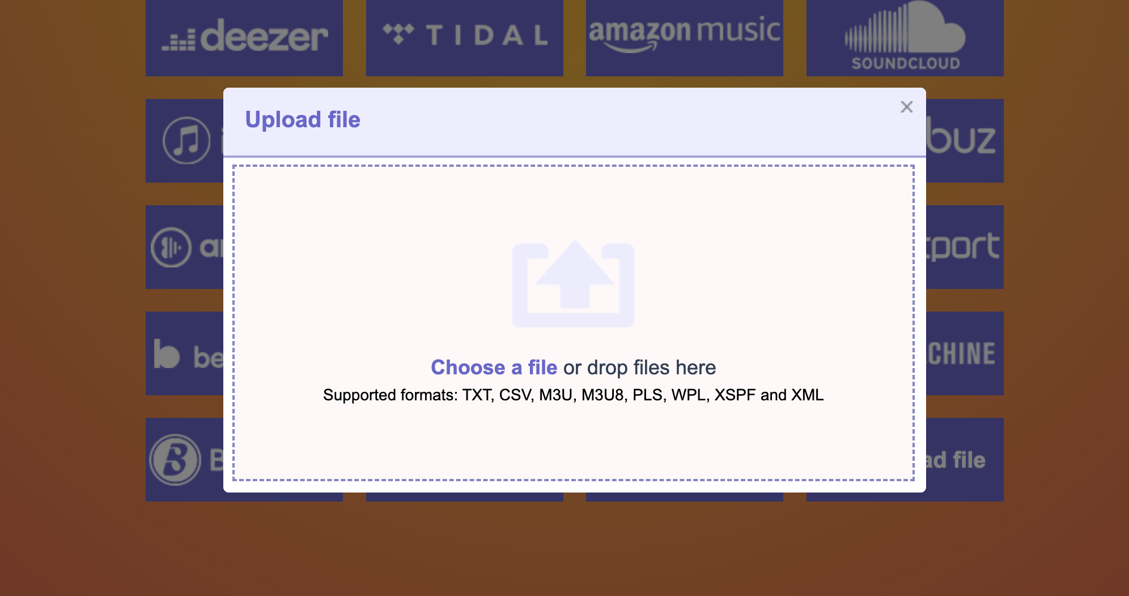
We will upload that csv file here

Slide 5
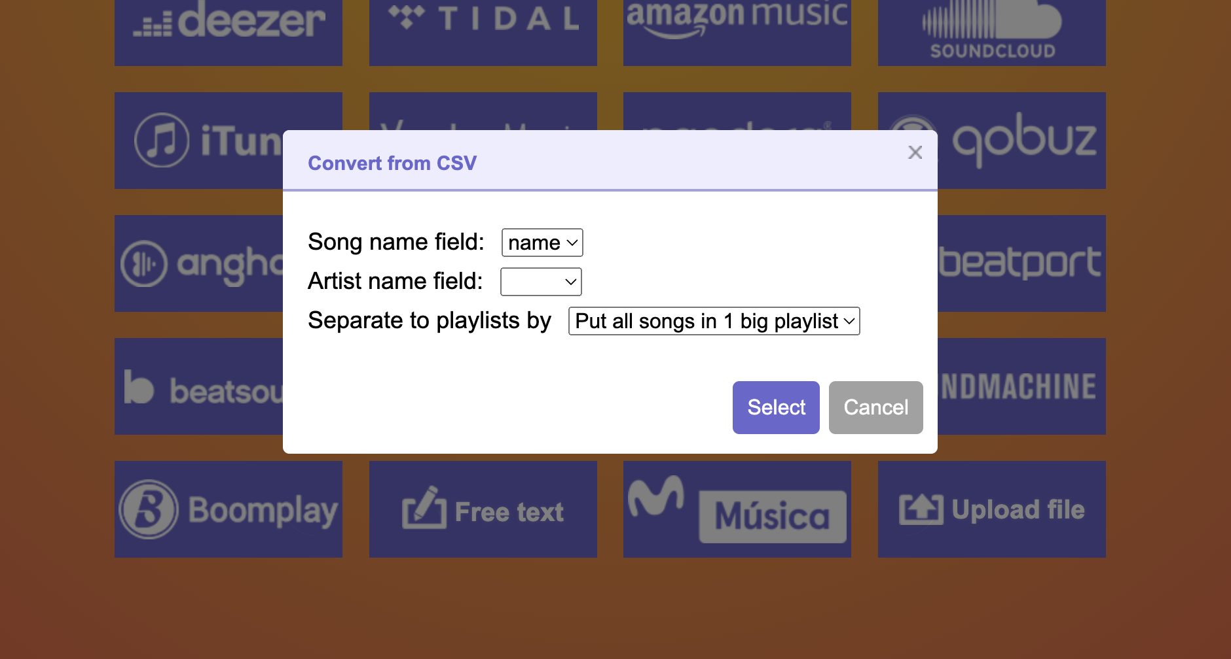
We will select that we need playlist from given csv file songs

Slide 6
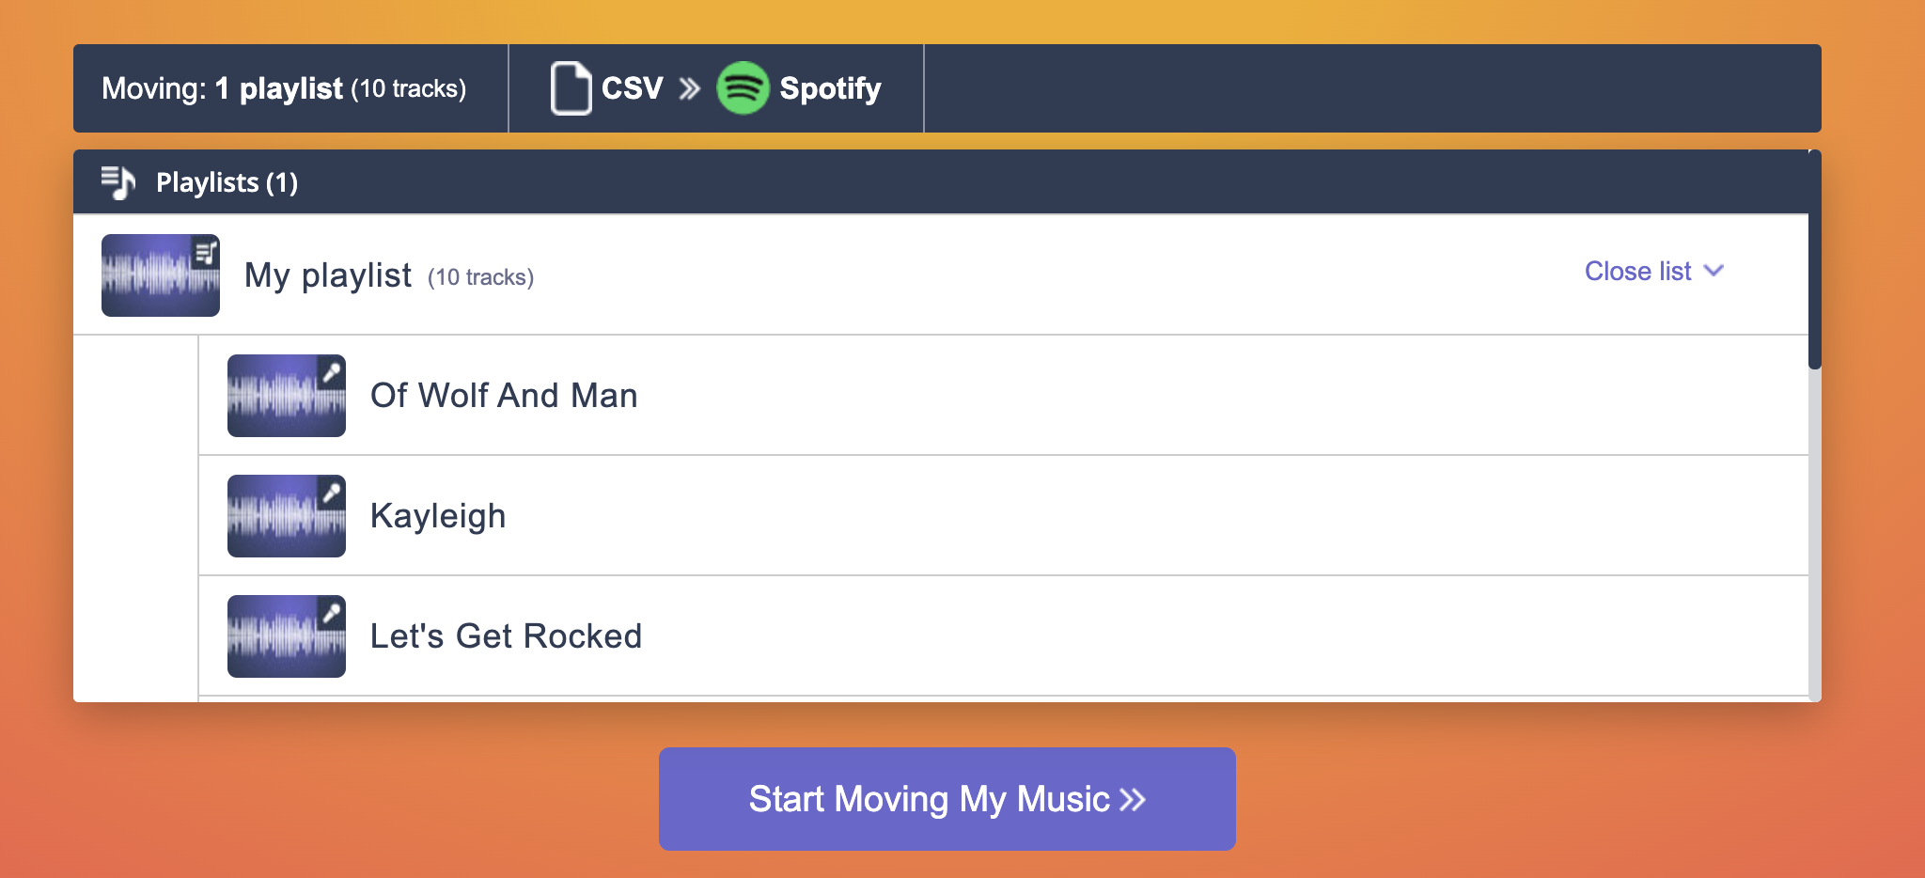
Then we will play those songs on spotify using the link

